Slide 1
Microsoft Azure
Dae Woo Kim (daewoo.kim@)
Technology Evangelist
Microsoft Korea

Slide 2

28
Azure regions around the world
Hyper-scale footprint
Latest launch was in October 2015- India – Central, India – South, India – West
GENERALLY AVAILABLE
6 new regions announced: Canada Central, Canada East, Germany Central,
Germany North East, United Kingdom (2 – regions TBD)
More than AWS and Google Cloud combined
Azure regions

Slide 3
Hyper-scale
Azure
Enterprise proven
Hybrid

Slide 4
>90,000
New Azure customer subscriptions/month
>1.5Million
SQL Databases running on Azure
>500Million
Users in Azure Active Directory
Azure momentum
1.5Trillion
Messages per month processed by Azure IoT
777Trillion
Storage Transactions per day
>40%
Revenue from Start-ups and ISVs
Notes:
>85% F500 customers on MS Cloud
>3,400 apps in Azure Marketplace
30 major certifications and attestations — more than any other major public cloud provider
13B authentications supported every week by Azure cloud services
1T messages a month are processed using Event Hub
>60B ingress events per day worldwide in Even Hub
More than 70T storage objects in Azure
More than 9M transactions per second processed by Azure Storage (nearly 3x growth YoY)
1.5M SQL DBs under management in Azure / Customer usage has increased 7x YoY
2.5B logins per week process to Azure SQL DB
External Traffic / web site hits (e.g. customer traffic only)- 83.46 billion hits/month
Total Sites/Apps (customer sites only) – 664k
3.4M Developers registered with Visual Studio Online

Slide 5

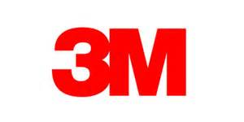

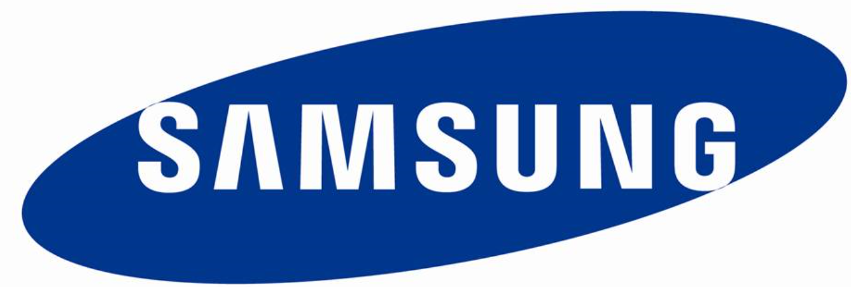





















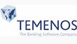



>80% of Fortune 500 use the Microsoft Cloud
Notes:
$1B in Revenue (compared to XX 3 years ago)
Only vendor as a leader in all 4 Gartner Cloud Infrastructure MQ's
>90K new customer subscriptions / month
80% of Fortune 500 customers use MS Cloud (or 58% use Azure)
23 regions announced globally, over 2x the number of AWS regions and 8x Google (3 Regions).
One of the largest networks in the world. We connect to over 1700 networks and have 1.4M miles of fiber in our datacenters
Azure has 22 major certifications and attestations-- more than any other major public cloud provider
Microsoft a Leader in Gartner Magic Quadrants
Cloud Infrastructure as a Service (May 2015)
Application Platform as a Service (March 2015)
Public Cloud Storage Services(June 2015)
X86 Server Virtualization(July 2014)
IDC predicts that 65% of enterprises will commit to hybrid cloud before 2016
Equifax (CPS – US)
details to come from Mark Jewett
Garuda: (Linux – APAC)
Garuda is Indonesia's national airline. They had a locally hosted e-Commerce web application built on open source technologies (PHP, MySQL and Linux Cent-OS Linux) that experienced repeated crashes and security breaches
Azure team stepped in and helped them lift and shift their solution to Azure in two weeks, without the need to re-architect their solution.
68% of the total consumption revenue(~400K) comes from OSS running on Azure
Tax Authority of Mexico (IaaS – LATAM) (SAT)
The Tax Authority of Mexico is the government entity responsible for collecting taxes from 46,3 million taxpayers in Mexico.
The Tax Authority of Mexico (SAT) wanted to upgrade its technology infrastructure to serve the growing demands of 40 million taxpayers who, as a result of changes to local legislation, had to interact electronically with the entity. SAT shifted to the cloud, using Microsoft Azure and other technologies to improve online service levels for citizens and businesses, increase tax control and tax collection, and reduce processing time and tax evasion
SAT wanted to replace its outdated systems and use new IT tools to establish more efficient, modern management processes for increasing tax collection, reducing tax evasion, supporting high data flows, serving hundreds of thousands of employees and taxpayers in simultaneous sessions, and offering those users better service through a simple tax-payment platform.
By using Microsoft Azure, SAT has been able to establish a modern technology environment that offers multiple online services simultaneously to millions of Mexicans, who must make transactions related to tax payment.
SAT works with AWS, IBM, Oracle, and others as part of their multi-vendor strategy. The account team (Raul Flores) having gained the trusted relationship with CIO was able to showcase the power and impact of Azure over other competitive technologies to win this deal

Slide 6
Virtual Machines
Getting started
Select image and VM size
New disk persisted in storage
Management portal
Windows Server
Boot VM from new disk
>_
Linux
Scripting
(Windows, Linux and Mac)
Blob Storage
General Purpose
Basic
Standard
Optimized Compute
Performance Optimized
Network Optimized
REST API
Cloud
Comprehensive
Networking

Slide 7
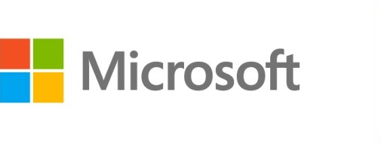






Azure Virtual Machines
Launch Windows Server and Linux in minutes
Scale from 1 to 1000s of VM Instances
Save money with per-minute billing
Open and extensible
Notes:
Slide Objectives:
High-level selling points of virtual machines.
Speaker Notes:
Both Linux and Windows are supported. It’s important to reiterate on this as many developers are still not aware of this.
Mention scaling at enterprise level using DSC, Puppet or Chef.
Emphasize on the openness – we are not forcing your to lock on Microsoft technologies. Instead, Azure is more open than ever. You can leverage your existing skills, tools and services, and Azure is providing more and more first-class supports for them.

Slide 8


Provisioning VM
Getting Started
Select Image and VM Size
New Disk Persisted in Storage
Windows Server
Management Portal
Boot VM from New Disk
Linux
>_
General Purpose
Basic
Standard
Optimized Compute
Performance Optimized
Network Optimized
Scripting
(Windows, Linux and Mac)
Cloud
REST API
Notes:
Slide Objective:
Explain workflow for provisioning VMs in the cloud
Speaker Notes:
You have three methods of starting this process: Build a VM from the portal, from the command line OR programmatically calling the REST API.
Once your choice of provisioning is made you will need to select the image and instance size to start from.
The newly created disk will be stored in blob storage and your machine will boot.

Slide 9

















VM Gallery
A collection of prebuilt images for various workloads
Windows Server 2012 R2
Ubuntu Server 14.04 LTS
CentOS 6.5
SUSE Linux
Enterprise Server
openSUSE 13.1
Oracle Linux 6.4.0.0.0
SQL Server 2014 Standard
Oracle Database 11g R2
SharePoint Server Farm
Microsoft Dynamics
GP 2013
Zulu 8
BizTalk Server 2013
SAP HANA
Developer Edition
Puppet Enterprise 3.2.3
Barracuda Web Application
Oracle WebLogic
Server 12.1.2
Visual Studio Ultimate 2013
Windows 8.1 Enterprise
Notes:
Slide Objective:
Explain a wide variety of images that you can choose from.
Speaker Notes:
First of all, you can choose from different Windows Servers and a variety of Linux implementations. [Click]
As well as pre-built images for different flavors of SQL Database and Oracle databases. [Click]
You can also choose from a number of first-party and certified third-party images for various application servers and infrastructural components. [Click]
And last but not least, if you are a MSDN subscriber, you also have access to Visual Studio images and client Windows systems such as Windows 7 and Windows 8.1 for your DevTest purposes.

Slide 10
Virtual Machine Sizes
General Purpose compute: Basic
General Purpose compute: Standard
Optimized Compute
Performance Optimized
Network Optimized
Notes:
Slide Objective:
Introduce different virtual machine sizes.
Speaker Notes:
http://azure.microsoft.com/en-us/pricing/details/virtual-machines/

Slide 11
Scale-up options
Highest value
Largest scale-up
A
D
G
N
DV2
Highest value
Most memory fastest CPUs
GPU-enabled virtual machines
SSD Storage Fast CPUs
>80,000 IOPs
Premium Storage
New generation of D family VMs
35% faster than D
Intel E5-2673 v3 CPUs
NVIDIA GPUs
Remote visualization
Compute-intensive + RDMA
Largest virtual machines Fastest storage in the public cloud

Slide 12
General Purpose Compute
Basic Tier
An economical option for development workloads, test servers, and other applications that don't require load balancing, auto-scaling, or memory-intensive virtual machines.
Instance | Cores | RAM | Disk sizes
A0 | 1 | 0.75 GB | 20 GB
A1 | 1 | 1.75 GB | 40 GB
A2 | 2 | 3.5 GB | 60 GB
A3 | 4 | 7 GB | 120 GB
A4 | 8 | 14 GB | 240 GB

Slide 13
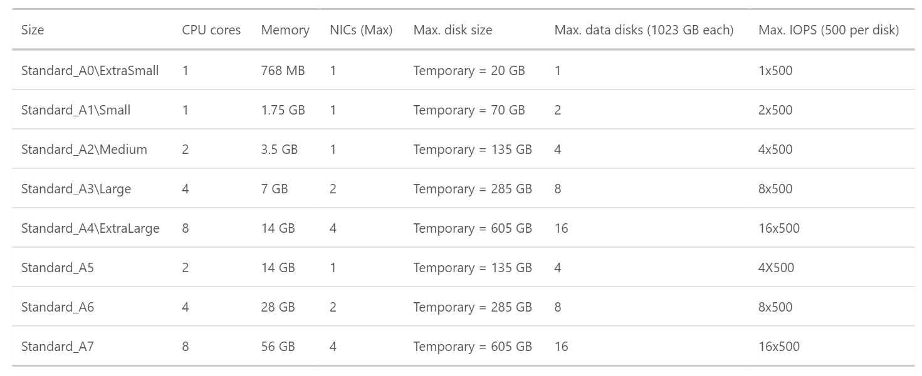
General Purpose Compute
Standard Tier
Offers the most flexibility. Supports all virtual machine configurations and features

Slide 14
General Purpose Compute
Network optimized with Infiniband support
Adds a 40Gbit/s InfiniBand network with remote direct memory access (RDMA) technology.
Instance | Cores | RAM | Disk sizes
A8 | 8 | 56 GB | 382 GB
A9 | 16 | 112 GB | 382 GB
Adds a 40Gbit/s InfiniBand network with remote direct memory access (RDMA) technology. Ideal for Message Passing Interface (MPI) applications, high-performance clusters, modeling and simulations, video encoding, and other compute or network intensive scenarios.
Notes:
This article provides background information and considerations for using the Azure A8, A9, A10, and A11 instances, also known as compute-intensiveinstances. Key features of these instances include:
High-performance hardware – The Azure datacenter hardware that runs these instances is designed and optimized for compute-intensive and network-intensive applications, including high-performance computing (HPC) cluster applications, modeling, and simulations.
RDMA network connection for MPI applications – When configured with the necessary network drivers, the A8 and A9 instances can communicate with other A8 and A9 instances over a low-latency, high-throughput network in Azure that is based on remote direct memory access (RDMA) technology. This feature can boost the performance of applications that use supported Linux or Windows Message Passing Interface (MPI) implementations.
Support for Linux and Windows HPC clusters – Deploy cluster management and job scheduling software on the A8, A9, A10, and A11 instances in Azure to create a stand-alone HPC cluster or to add capacity to an on-premises cluster. Like other Azure VM sizes, the A8, A9, A10, and A11 instances support standard or custom Windows Server and Linux operating system images or Azure Resource Manager templates in Azure VMs (IaaS), or Azure Guest OS releases in cloud services (PaaS, for Windows Server only).
NOTE:
A10 and A11 instances have the same performance optimizations and specifications as the A8 and A9 instances. However, they do not include access to the RDMA network in Azure. They are designed for HPC applications that do not require constant and low-latency communication between nodes, also known as parametric or embarrassingly parallel applications.

Slide 15
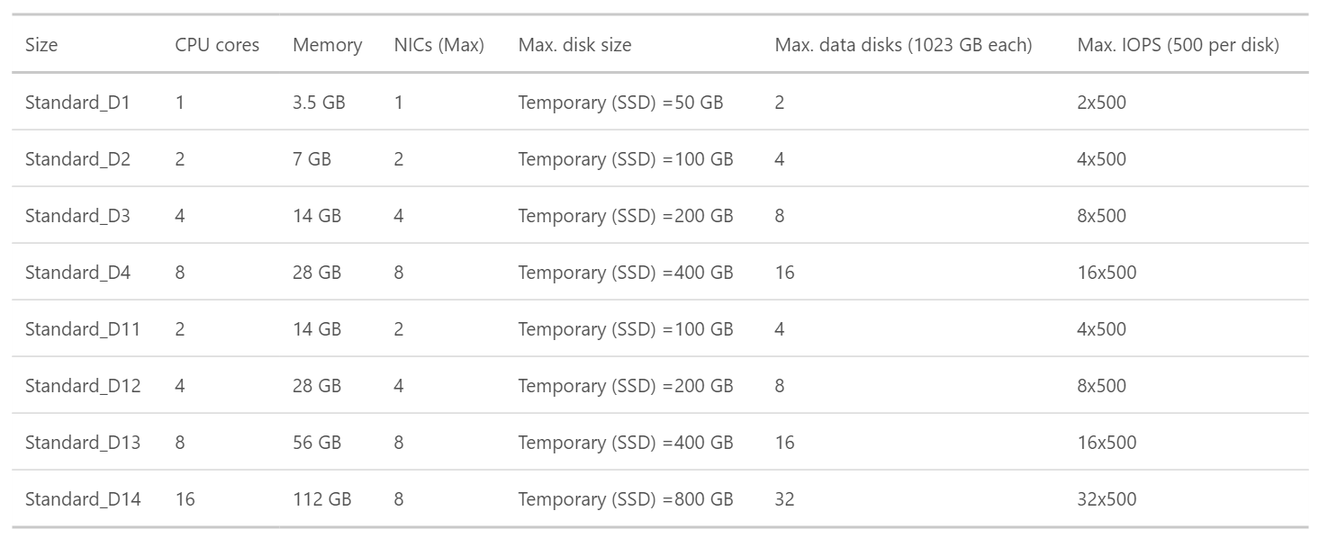
Optimized Compute (D Tier)- 60% faster CPUs, more memory, and local SSD

Slide 16
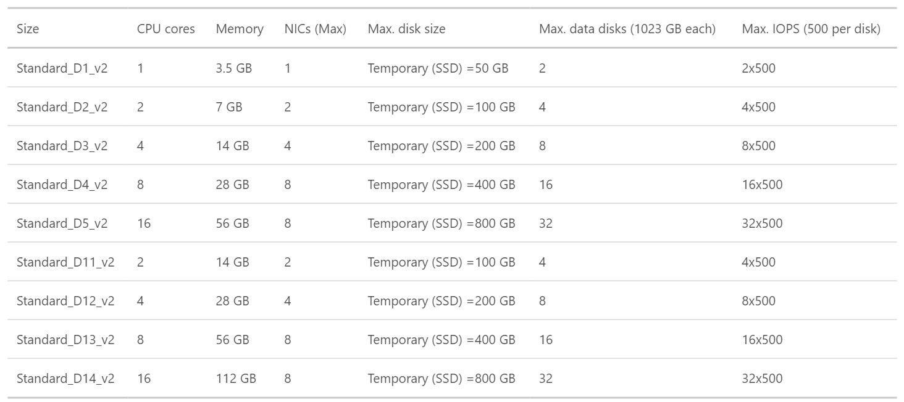
Dv2 Series- 35% faster than D series, 2.4 GHz Intel Xeon® E5-2673 v3 (Haswell) processor
Notes:
Dv2-series, a follow-on to the original D-series, features a more powerful CPU. The Dv2-series CPU is about 35% faster than the D-series CPU. It is based on the latest generation 2.4 GHz Intel Xeon® E5-2673 v3 (Haswell) processor, and with the Intel Turbo Boost Technology 2.0, can go up to 3.2 GHz. The Dv2-series has the same memory and disk configurations as the D-series.

Slide 17
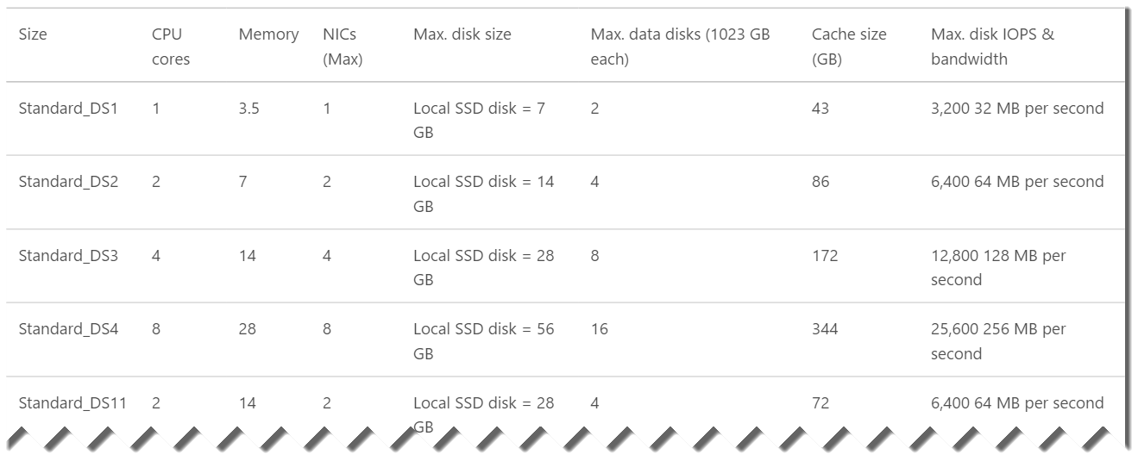
DS-series VMs can use Premium Storage- high-performance, low-latency storage.
Notes:
DS-series and GS-series VMs can use Premium Storage, which provides high-performance, low-latency storage for I/O intensive workloads. These VMs use solid-state drives (SSDs) to host a virtual machine’s disks and also provide a local SSD disk cache. Premium Storage is available in certain regions.

Slide 18
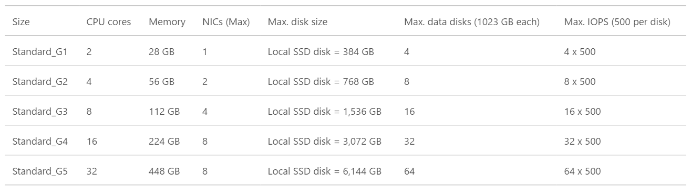
G-series VMs offer the most memory and run on hosts that have Intel Xeon E5 V3 family processors.

Slide 19
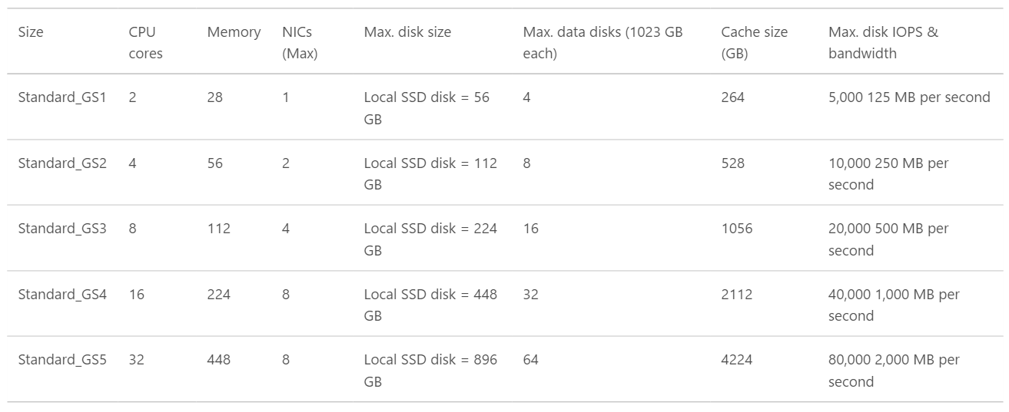
GS-series VMs , Godzilla ++ (Premium Storage- high-performance, low-latency storage for I/O intensive workloads.)

Slide 20
Microsoft Linux

Slide 21
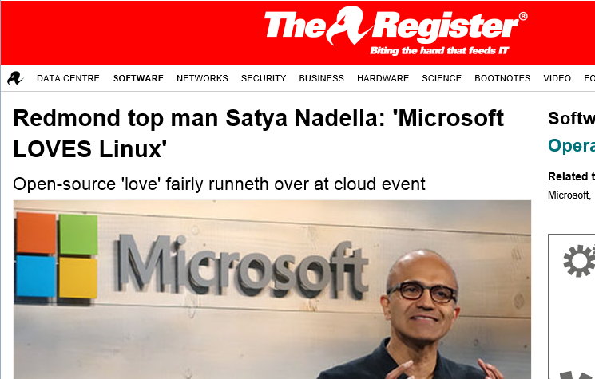
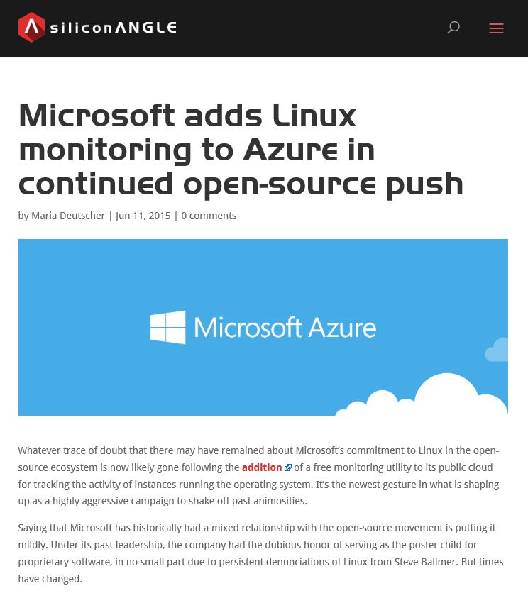
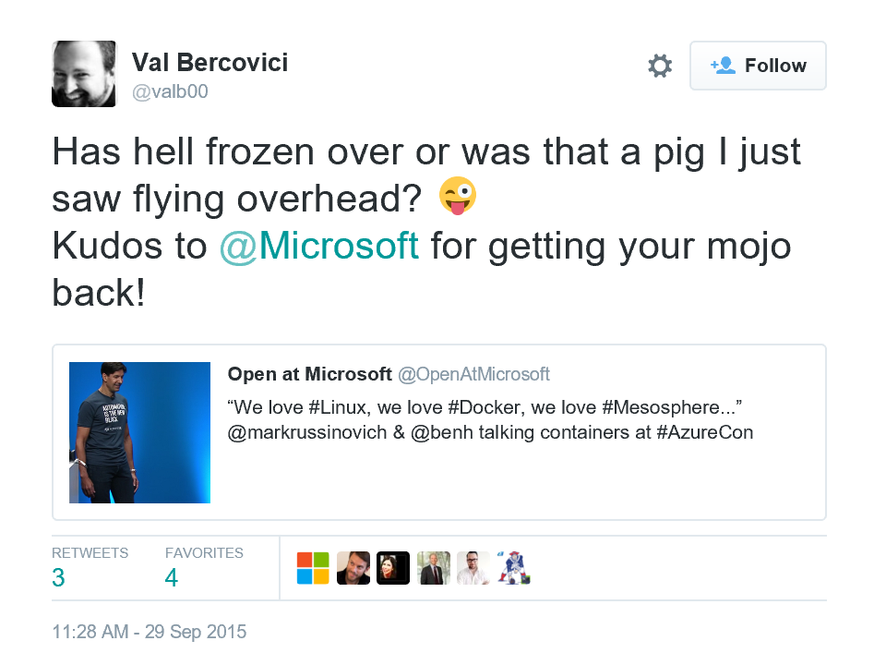
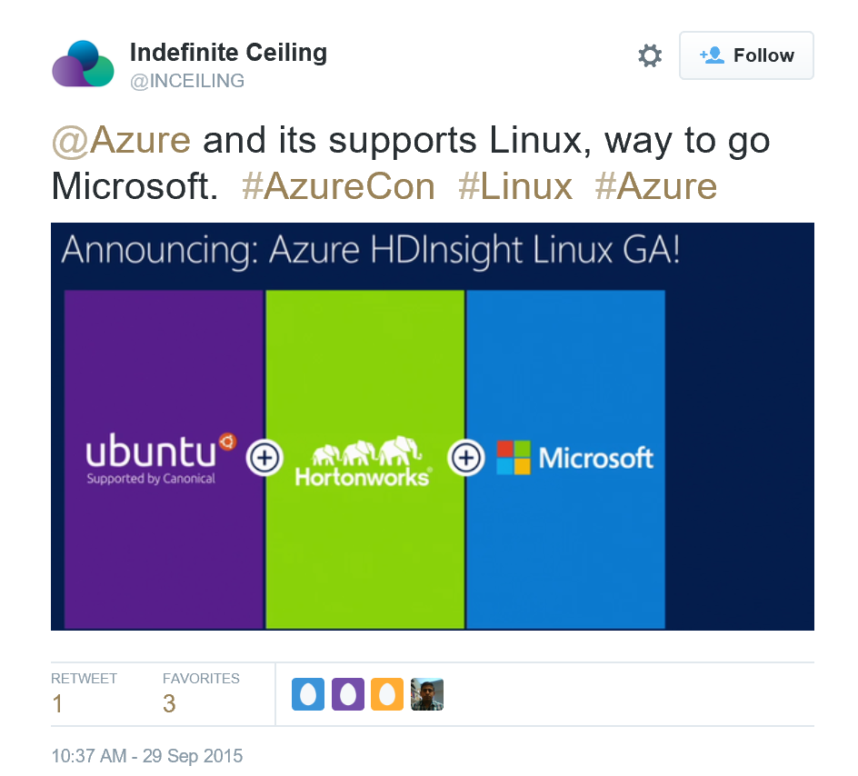
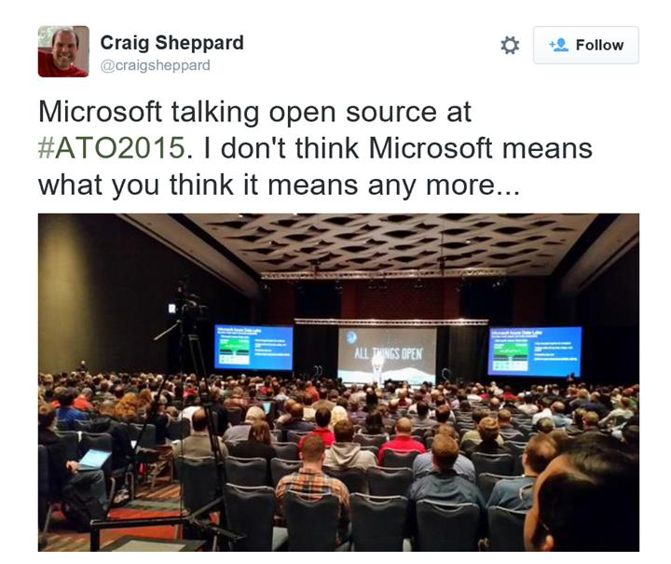
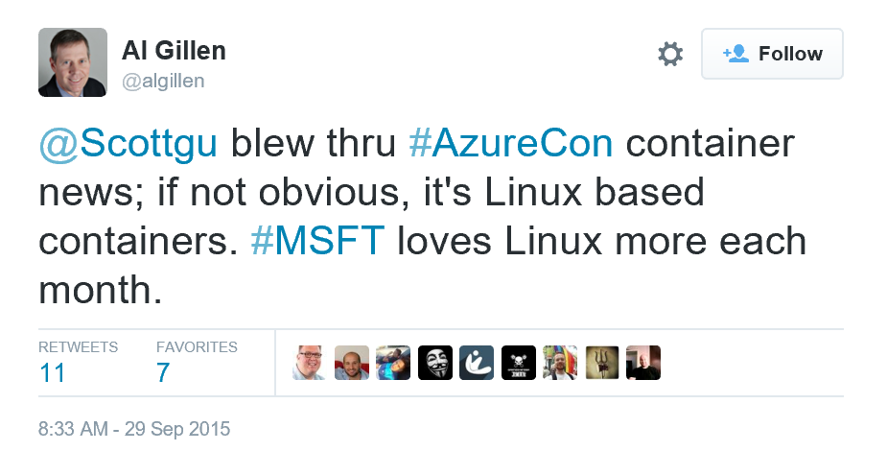

Slide 22
Microsoft is committed to Linux and open source
Linux is a real business for Microsoft
25% of IaaS VMs in Azure are Linux
System Center manages hundreds of thousands of Linux/UNIX servers
Many enterprises and service providers
run Linux as a guest on Hyper-V
… and we’re been in a long open source journey!
System Center has managed Linux and
UNIX servers since 2009
Linux drivers for Hyper-V available since 2010
Azure IaaS has run
Linux VMs since
“day 1” in 2013
Linux and open source are a fundamental part of how we do business
Today

Slide 23


Get started
Visit azure.microsoft.com

